Slide 1
MDM Company
June 1, 2021
DIGITAL BRAINSTORM
A creative way to encourage everyone to think and share ideas.

Slide 2
MDM Company
June 1, 2021
TODAY'S AGENDA
1
Introduction to the Session
3
Digital Brainstorm
2
Team Check-in and Icebreaker
4
Summary and Action Items

Slide 3



MDM Company
June 1, 2021
Tomas and Chloe
INTRODUCTION
Tomas and Chloe will be our facilitators for this session.
The goal of our session is to turn chaos into clarity. As facilitators,
our role is to keep the session on track and to ensure everyone participates in the discussion.

Slide 4


TEAM CHECK-IN
1
2
3
Click the More tab
in the editor side panel.
Select the Emoji
or GIPHY app.
Browse and click the Emoji or GIF you want to use.
How are you feeling?
Choose an Emoji, GIF, or image from a mood meter that best represents how you feel at the moment.
Time: 5 minutes

Slide 5
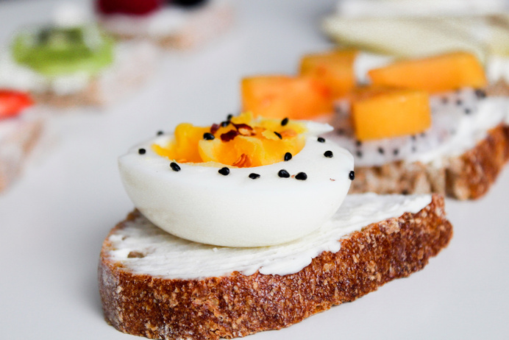
ICEBREAKER
Copy a sticky note, then write your thoughts.
Copy a sticky note, then write your thoughts.
Before we start with the session, let's warm up a little
with this icebreaker question:
What did you have for breakfast today?
Below are suggestions for icebreaker questions:
What's your morning routine?
What did you have for breakfast today?
What’s a random act of kindness you did for a stranger?
What's the most challenging thing you've done in life?
What's your favorite dessert?
Time: 5 minutes

Slide 6
MDM Company
June 1, 2021
GET THOSE CREATIVE JUICES FLOWING!
Let's begin.

Slide 7
MDM Company
June 1, 2021
Copy a sticky note, then we'll write our thoughts, ideas, and inspiration.
1
DIGITAL BRAINSTORM
Copy a sticky note, then write your thoughts.
Copy a sticky note, then write your thoughts.
Copy a sticky note, then write your thoughts.
Starting on a new project begins with a curation of ideas. This digital brainstorm session will allow us to lay down
and organize all our thoughts, ideas, and inspiration.
Next, we will vote on ideas that are promising
and add comments.
Use the stars to vote which ones we like to pursue.
2
Circle or comment on any
promising ideas.
3
Yes!
This is
great!

Slide 8
BRAINSTORM TOPIC
1
2
3
Yes!
Copy a sticky note, then write your thoughts.
Add your
idea here
Vote for your favorite
ideas with these stickers.
Put these reaction stickers to any
promising ideas.
This is
great!
This is
great!
Brainstorm area
Our favorite ideas

Slide 9
MDM Company
June 1, 2021
ACTION ITEMS
1
Write action items in the boxes.
Type your idea here.
Type your idea here.
Type your idea here.
Let's go back to the previous pages and
synthesize what next actions are appropriate
for us to move forward as a group.
Drag your photo under the
action item you want to own.
2

Slide 10




ACTION ITEMS
Action 1
Action 2
1
Write action items in the boxes.
Drag your photo under the
action item you want to own.
2
Action 3
Action 4
Type your idea here.

Slide 11
MDM Company
June 1, 2021
THE MIND IS JUST LIKE
A MUSCLE — THE MORE YOU EXERCISE IT, THE STRONGER IT GETS AND THE MORE
IT CAN EXPAND.
Idowu Koyenikan

Slide 12
MDM Company
June 1, 2021
THAT'S A WRAP!
Thank you for participating.

Slide 13
MDM Company
June 1, 2021
Icons and Illustrations
ICONS AND ILLUSTRATIONS RESOURCE PAGE
Yes!
This is
great!
Use these free recolorable icons and
illustrations in your Canva design.
Type your idea here.

